Slide 1
AIRLINES HACKING: ADS-B VULNERABILITIES,
IN-FLIGHT WIFI EXPLOITS, AND MAINTENANCE
SYSTEM THREATS

Slide 2





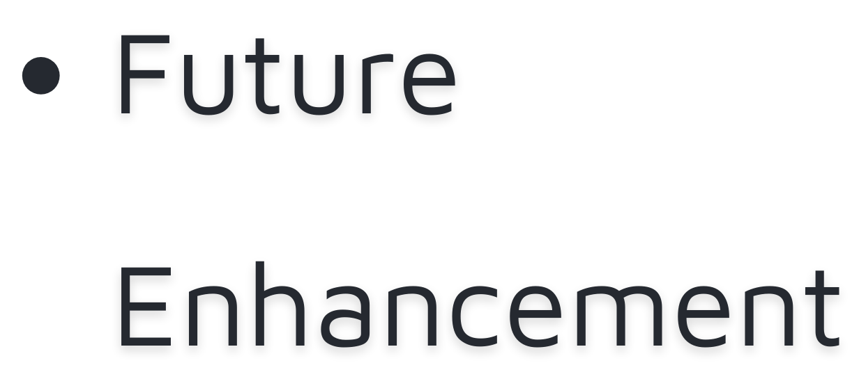





OVERVIEW

Slide 3
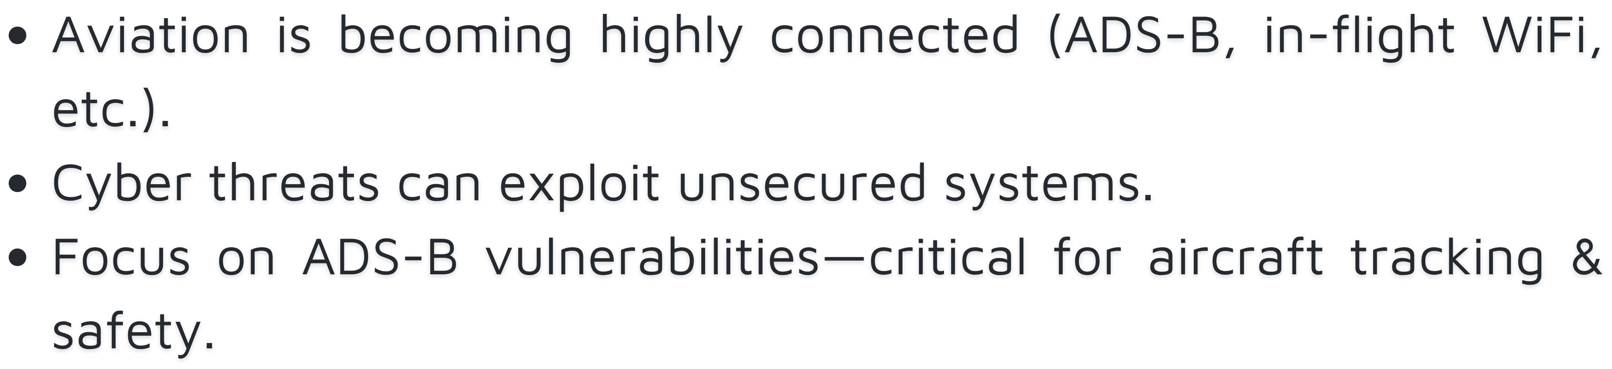
INTRODUCTION

Slide 4
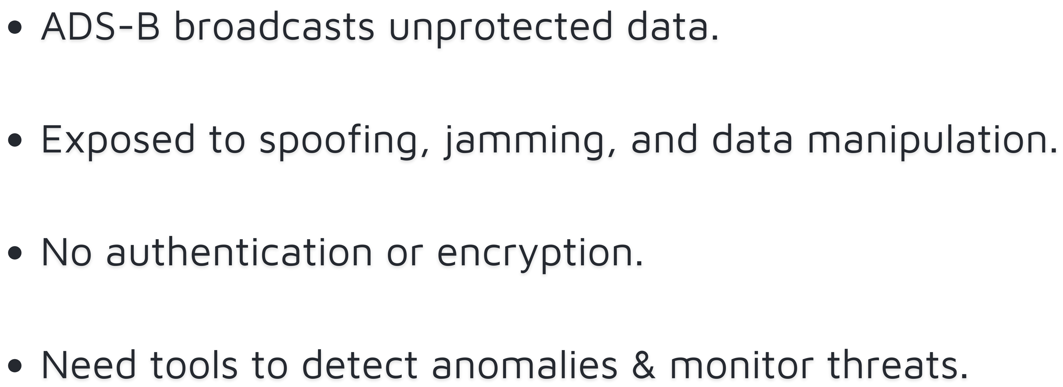
PROBLEM

Slide 5
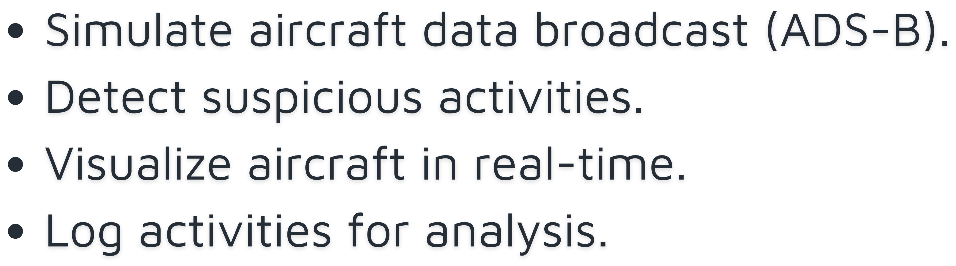



OBJECTIVE

Slide 6
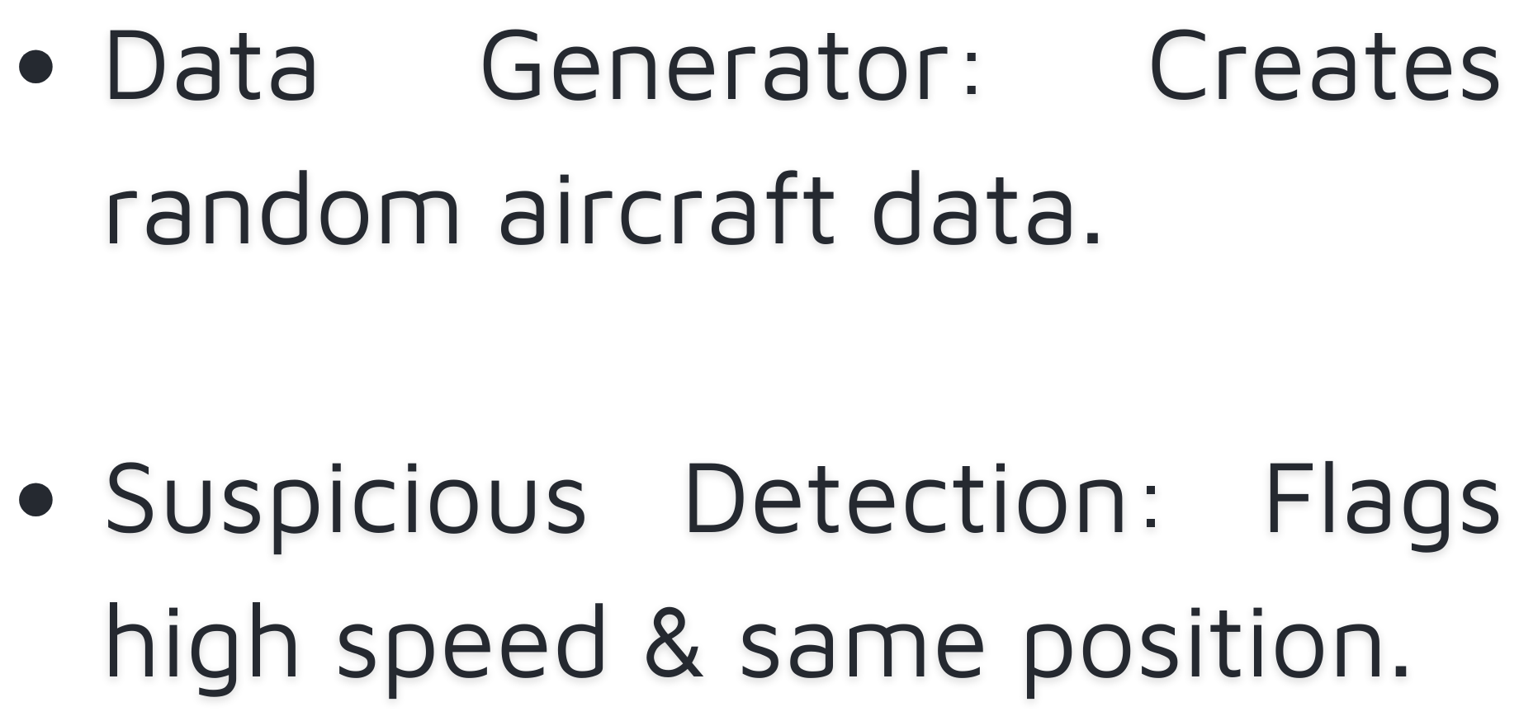
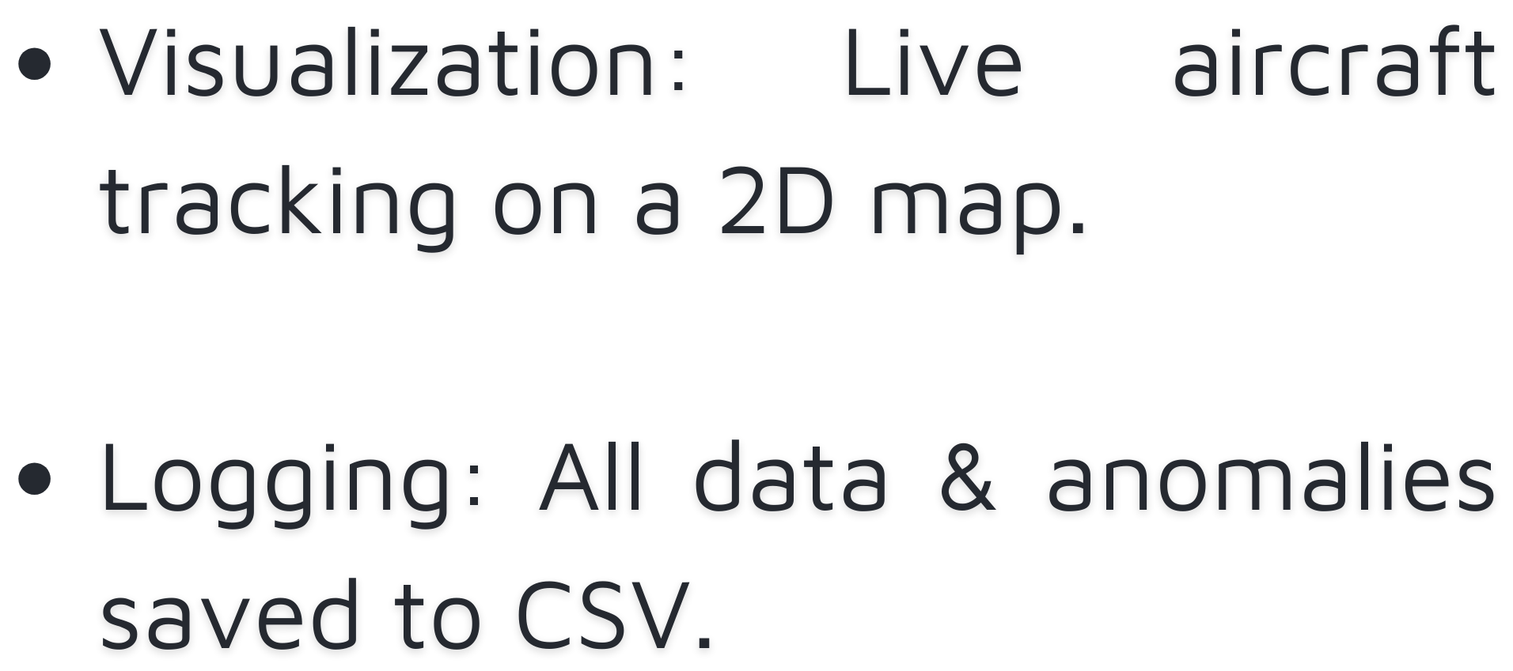
CODE & TOOL BREAKDOWN

Slide 7
REAL-WORLD USE
CASES
10
8
6
4
2
0
Item 1
Item 2
Item 3

Slide 8
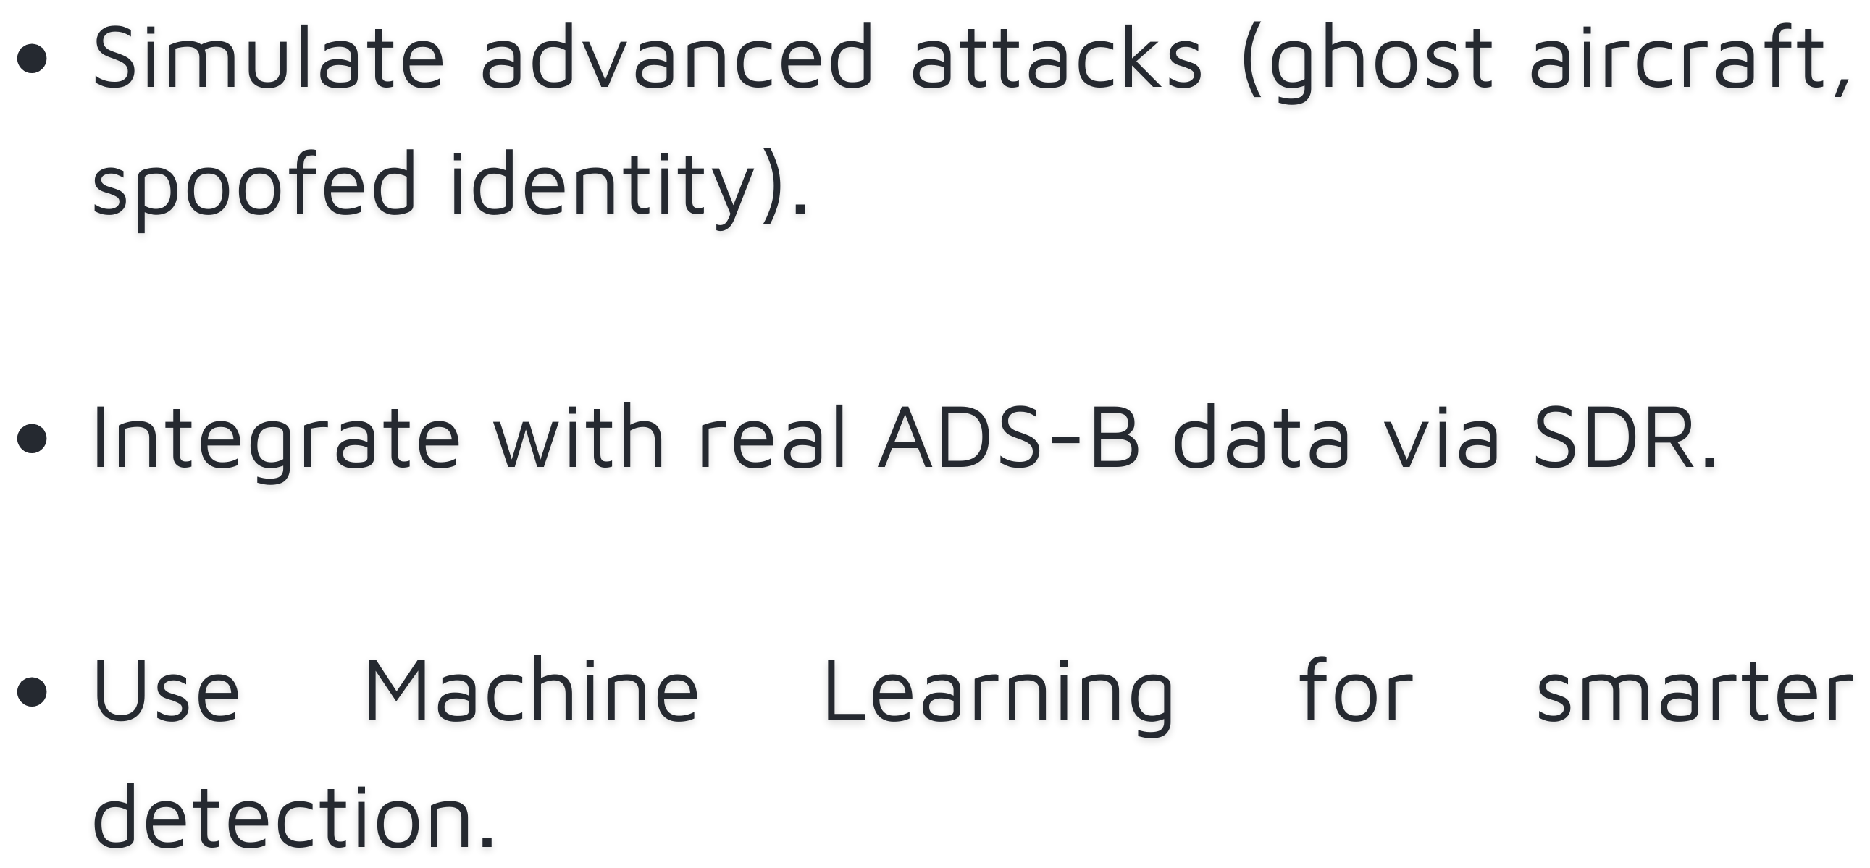
FUTURE
ENHANCEMENTS

Slide 9
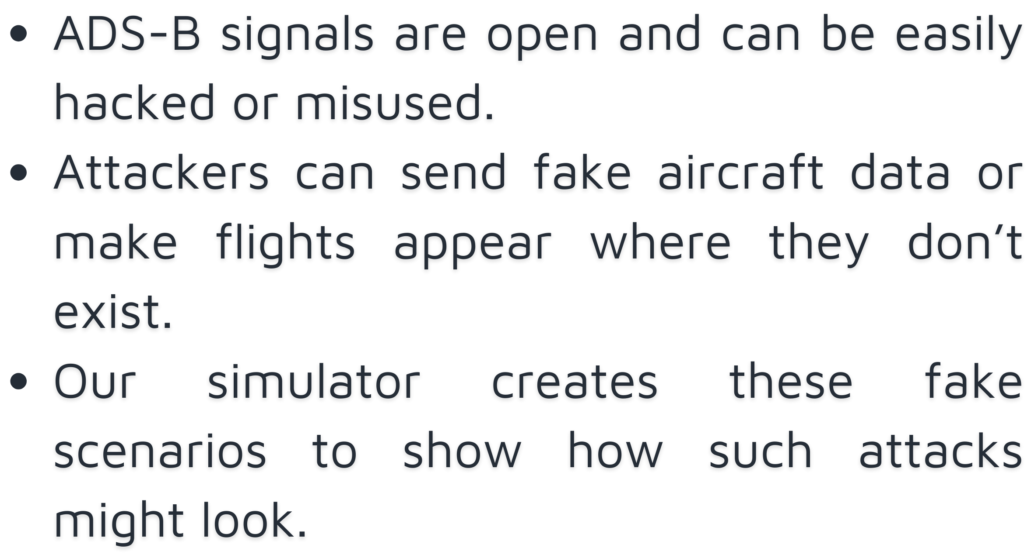
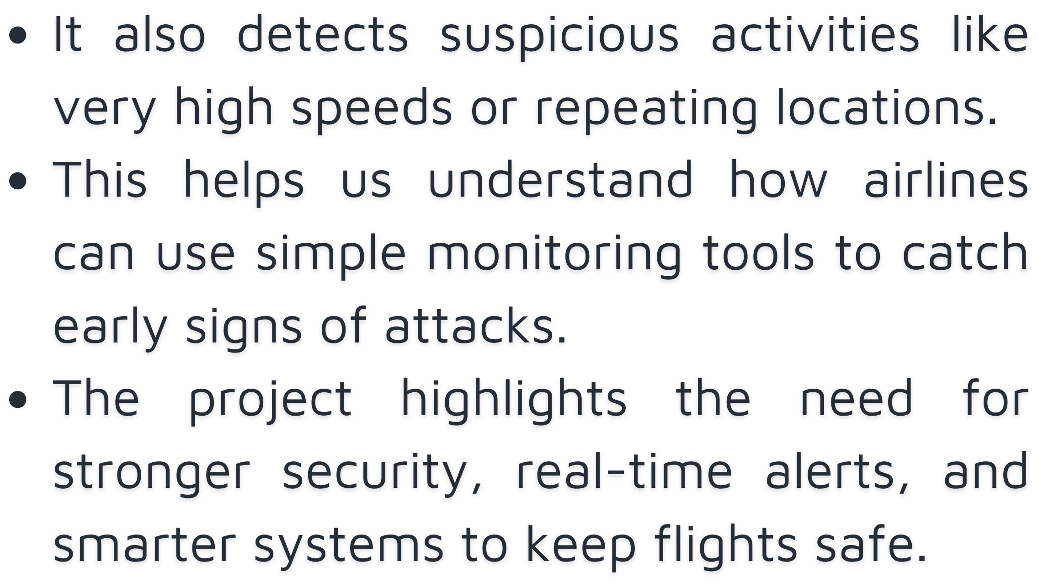
CONCLUSION

Slide 10

Thank You

